Slide 1
Advanced Modeling for Distribution Planning with OpenDSS
Instructor
Roger C. Dugan Sr. Technical Executive Sacramento, California June 22-23, 2017

Slide 2

Instructor
Roger C. Dugan, Life Fellow, IEEE
Roger is a Sr. Technical Executive with EPRI in Knoxville, Tennessee USA. He has over 45 years of combined experience in distribution engineering with EPRI, Electrotek Concepts, and Cooper Power Systems. He holds the BSEE degree from Ohio University and the Master of Engineering in Electric Power Engineering degree from Rensselaer Polytechnic Institute, Troy, NY. Roger has worked on many diverse aspects of power engineering over his career because of his interests in applying computer methods to power system simulation. Beginning with a student internship with Columbus and Southern Ohio Electric Co, his work has been focused on Distribution Engineering. He was elected a Fellow of the IEEE for his contributions in harmonics and transients analysis. Recently, he has been very active in distributed generation, particularly as it applies to utility distribution systems and distribution system analysis. He was the 2005 recipient of the IEEE Excellence in Distribution Engineering Award. He is coauthor of Electrical Power Systems Quality published by McGraw-Hill, now in its 3rd edition. He serves on the IEEE PES Distribution System Analysis Subcommittee and is active in the Distribution Test Feeders WG.

Slide 3
Loadshapes and Quasi-Static Time-Series (QSTS) Simulation

Slide 4
Loadshapes
A key feature of OpenDSS
Sequential time simulation is required for many Smart Grid analyses
Basic time-varying modes that use Loadshape objects
Daily (nominally 24 h, 1 h steps)
Yearly (nominally 8760 h, 1 h steps)
Dutycycle (nominal step size 1 s .. 5 m)
(used for wind and solar)
Learning to work with Loadshapes is essential skill for OpenDSS users

Slide 5
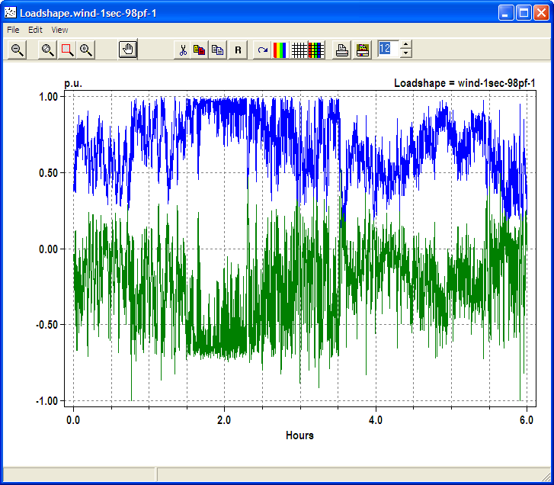
Example Loadshape for Wind Turbine Output
Watts
Vars

Slide 6
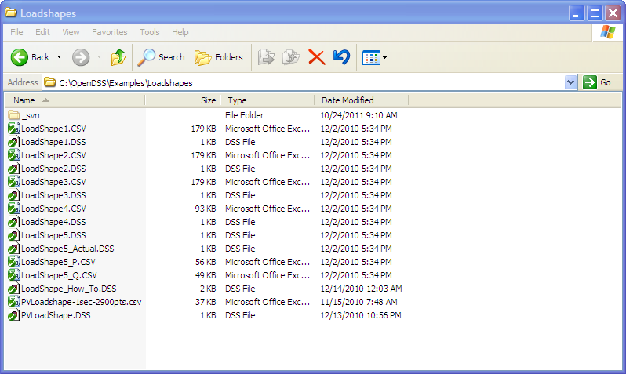
Example Loadshapes Provided in Examples Folder

Slide 7
How to Define
Clear
! Example scripts for loading and plotting loadshapes out of the loadshape library
! You have to have a circuit defined to load in loadshapes.
New Circuit.LoadshapeExamples
! directly ...
New "LoadShape.LoadShape1a" npts=8760 interval=1.0 mult=(File=LoadShape1.csv)
Plot Loadshape Object=Loadshape1a ! execute this to prove you got it
! or using Redirect
Redirect Loadshape1.DSS ! Load in Loadshape 1
Plot Loadshape Object=Loadshape1

Slide 8
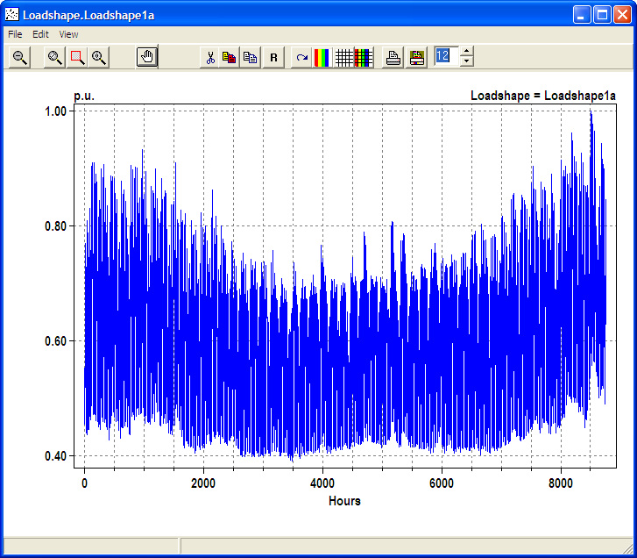
Example Yearly LoadShape, Winter Peaking

Slide 9
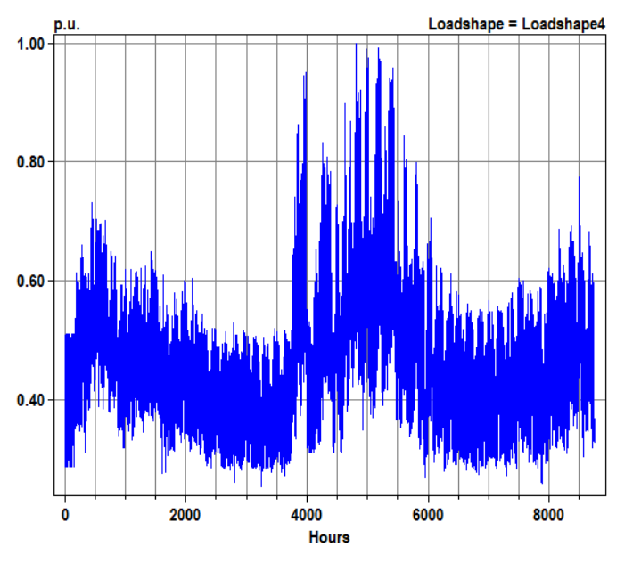
Example Loadshape – Summer Peaking

Slide 10
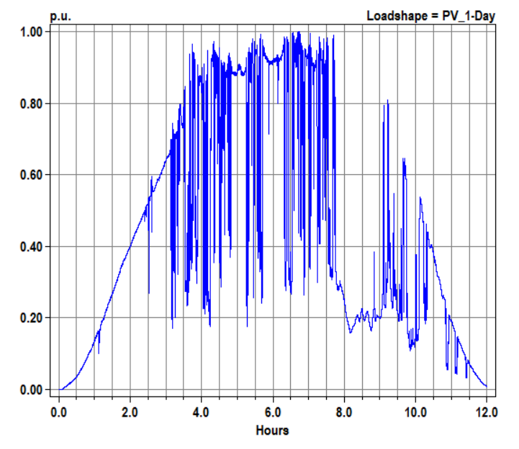
Example Loadshape – One Day Solar (1-s interval)

Slide 11
Loadshape Interpolation
The OpenDSS LOADSHAPE class uses two different types of interpolation depending on it is defined
Fixed interval data
Variable interval data
Fixed interval data.
This is the Default. INTERVAL property defaults to 1 hour.
You can set it to another value or to 0.
The SINTERVAL and MINTERVAL properties facilitate defining intervals in second or minutes.
INTERVAL > 0 implies fixed interval data
CSV files --one numeric value per line.
Interpolation algorithm assumes the value REMAINS CONSTANT over the entire interval
The HOUR array property is ignored

Slide 12
Loadshape Interpolation, Cont’d
For LINEAR INTERPOLATION between the points, define INTERVAL=0.
Then both the time and multiplier values for the loadshape using the HOUR, MULT, and QMULT array properties.
Alternatively, you may use the CSVFILE, DBLFILE, or SNGFILE properties.
Enter both the time in hours and the multiplier values.
A CSV file would have two values per line separated by a comma or whitespace.
The variable interval interpolation could be a little bit slower than the fixed interval data because there is more work to do to compute the factor.

Slide 13
Importing Packed Binary Files
For simulations, such as AMI load data, requiring large volumes of Loadshapes to be imported, using packed binary files can save time
Standard CSV or TXT file
Mult=[file=myfile.txt]
File of doubles
Mult=[dblfile=myfile.dbl]
File of singles
Mult=[sngfile=myfile.sng]

Slide 14
Defining Array Properties Using CSV files
Syntax:
mult=[File=myMultiColumnFile.CSV, Column=n, Header=Yes/No]
Allows use of multicolumn CSV files with a single header row.
Example:
New Loadshape.Ramp2 npts=4000 sInterval=1 mult=(file=MultiChannelTest.csv, column=3, header=yes)
Imports the 3rd column from the file, skipping the header row

Slide 15
Built-in Simulation Modes

Slide 16
Built-in Solution Modes
Snapshot (static) Power Flow
Direct (non-iterative)
Daily mode (default: 24 1-hr increments)
Yearly mode (default 8760 1-hr increments)
Duty cycle (1-s to 5-s increments)
Dynamics (electromechanical transients)
Fault study
Monte carlo fault study
Harmonic
HarmonicT
Custom user-defined solutions

Slide 17
Snapshot Mode (Static)
This is the default solution mode after creating a new circuit model
The basic power flow solution mode for the OpenDSS
Performs a single solution each time Solve is issued
Control mode defaults to “Static”
Defaults to iterative power flow solution
Load model is “Powerflow”

Slide 18
Direct Mode
Performs a non-iterative solution of the present system admittance equation
Loads and Generators represented by constant impedance
Value in their Norton equivalents
This is a useful mode when convergence is difficult, but needed to perform Harmonic, Dynamic, or Faultstudy mode solution.
Will nearly always give a reasonable starting point for these solution modes

Slide 19
Daily Mode
Defaults
Stepsize = 1.0 h
Controlmode = static
Number = 24
Designed for simulations of a load profile for one day for distribution planning studies, losses, other energy studies
Time step of 0.25 h to 1.0 h typically
One or more days (change “Number” property)
Set the Daily= property of Load and Generator to follow a loadshape
Similar functionality to Yearly mode except behavior of Energymeter demand-interval data

Slide 20
Yearly Mode
Defaults
Stepsize = 1.0 h
Controlmode = static
Number = 8760
Designed for annual simulations for distribution planning studies, losses, other energy studies
Time step of 0.25 .. 1.0 h typically
All or part of year
Set the Yearly= property of Load and Generator to follow a loadshape
May require CloseDI command at the end if DemandInterval used

Slide 21
DutyCycle Mode
Defaults
Stepsize = 1.0 s
Controlmode = time
Number = 100
Designed for simulations of wind turbine output, solar PV output, stone crushers, and other impulse loads
Time step of 1 – 10 s
Duration of a few minutes up to 1 day
Some are now using this for long periods for solar PV generation
Set the Duty= property of Load and Generator to follow a loadshape

Slide 22
Dynamics Mode
Defaults
Stepsize = 0.001 s
Controlmode = time
Number = 100
Electromechanical transients simulations
Generator state variables integrated
Predictor-corrector
Intended for simulations of a few seconds duration

Slide 23
FaultStudy Mode
Defaults to dynamic model so machine contributions to faults are included
Requires a power flow solution to start
Solve causes short circuit equivalents to be computed for each bus
Follow immediately by “Show Faultstudy” report
Computes fault currents
Typical sequence:
Solve
Solve mode=Faultstudy
Show Faultstudy

Slide 24
Monte Carlo Fault Study Mode
A special kind of fault study useful for some reliability or power quality studies
The circuit model is first populated by a selected number of Fault objects.
Example: SLG faults at all buses
User can distribute faults in any manner
This solution mode activates the faults one at a time and computes a Snapshot solution with loads modeled as admittances
Be sure to place Monitors around the circuit where you want to see voltage sag magnitudes, fault currents, etc.
Answers will come fast!

Slide 25
Harmonic Mode
Defaults
Controlmode = OFF
Loadmodel = Admittance
Performs a direct solution at each frequency presently defined in the problem by Spectrum objects.
See Harmonics option
Requires a power flow solution
Typical sequence
Solve
Solve mode=harmonics
Be sure you have Monitor objects defined!

Slide 26
Control Modes
Control models are a key feature of OpenDSS and it is important to understand how they work in different solution modes.
Key Modes
OFF
Controls are disabled; controlled parameters stay the same as last value
TIME
Controls operate when solution reaches a specified time. For time steps smaller than control delay
STATIC
For time steps larger than control delay. Controls operate in sequence of time delay values.
Shortest delay operates first
Default for Snapshot, Daily, Yearly modes

